Slide 1


Slide 2
IMBD TOP 100 DRAMA MOVIES
PRESENTED BY:
DRAMA KING’S:
USMONOV FAYYOZJON
ISSIFU SIA AWUDU
VISHWANATH SINGA

Slide 3


FLOW OF WEB SCRAPPING

Slide 4
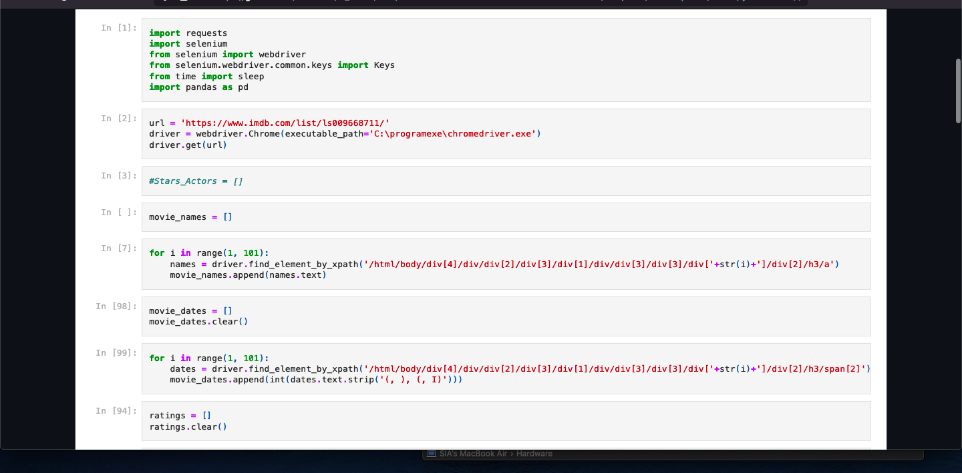
We Used Selenium

Slide 5
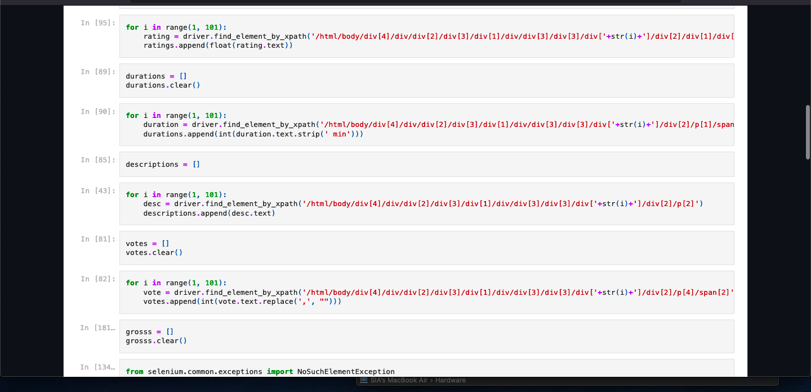
This is the part we defined: Durations, descriptions, votes and gross

Slide 6
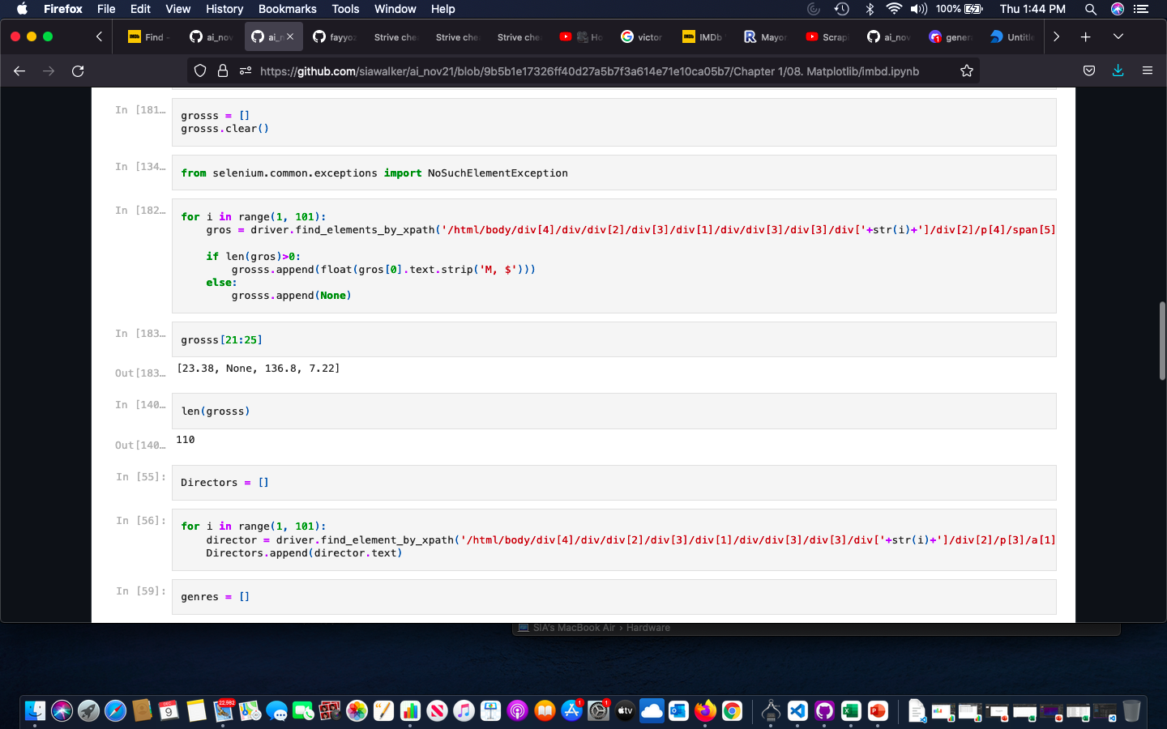
Here we tried to make the length of the gross be in sync (100) since we have null
We also defined Director’s

Slide 7
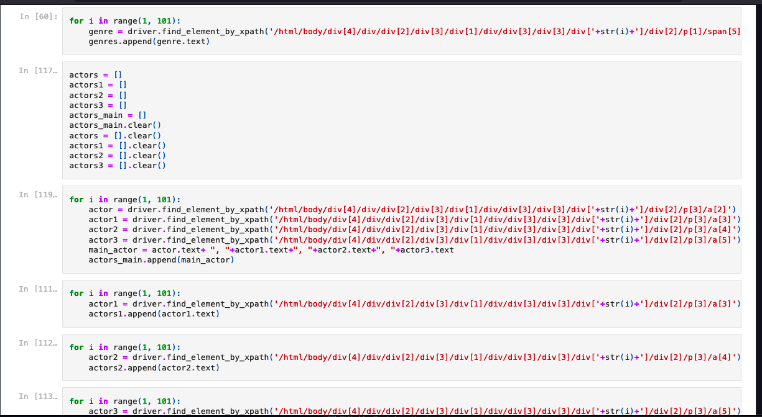
We defined the actors

Slide 8
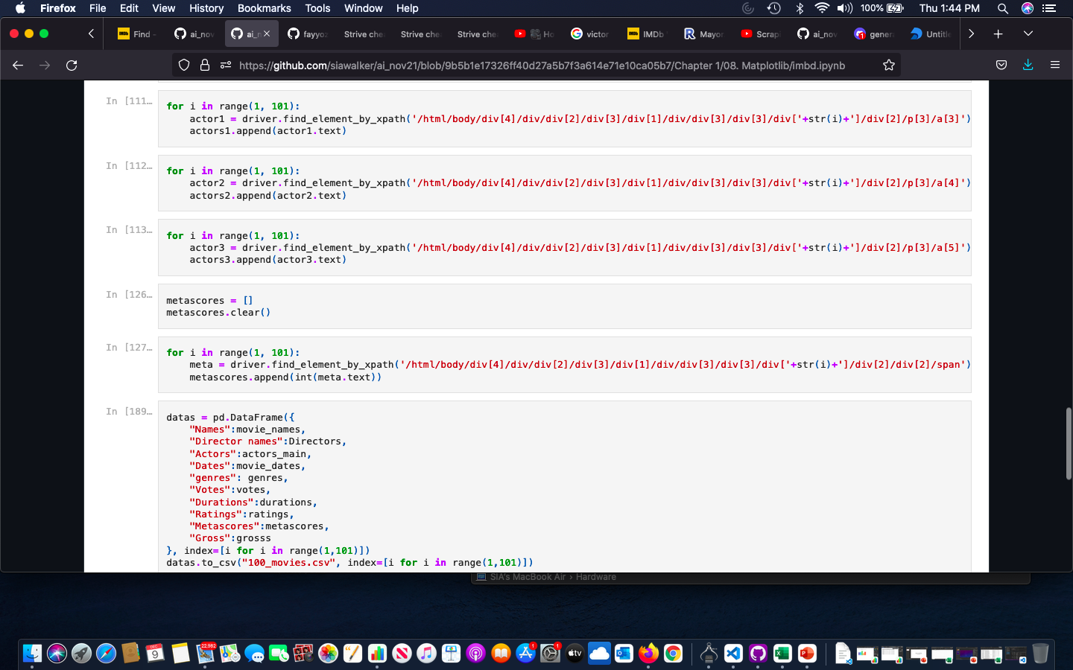
Using Pandas we framed the various variables

Slide 9
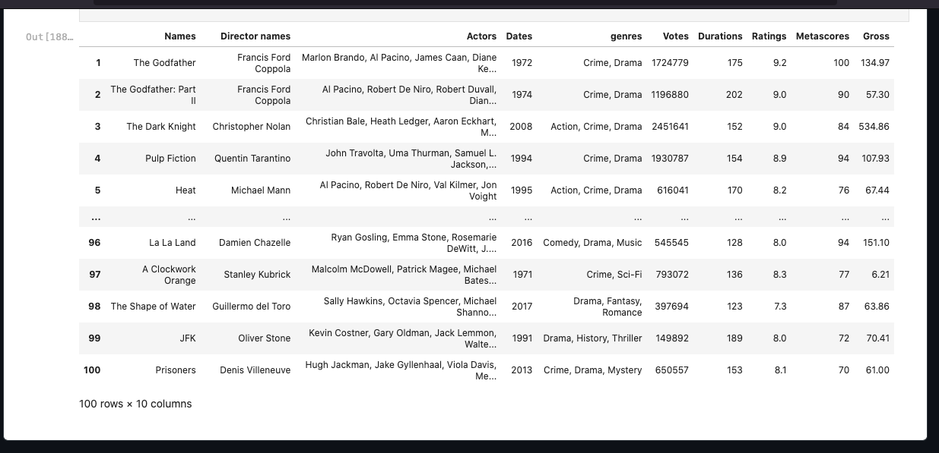
Snapshot of the Outcome of the frame and the work so far

Slide 10

MATLAB PLOTTING AND SUMMARY

Slide 11
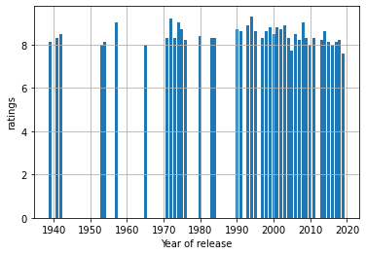
Relationship between Ratings and Year of release

Slide 12
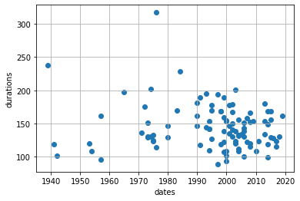
Relationship between Year of release and Duration of drama

Slide 13
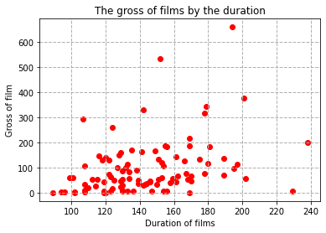
Relationship between Duration and Gross of Film

Slide 14
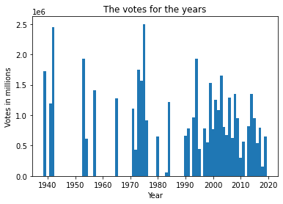
Relationship between Votes and Year of Release

Slide 15
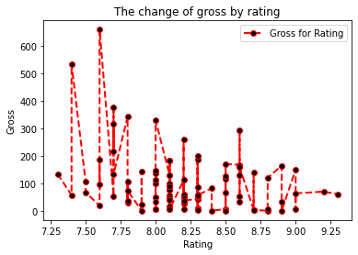
Relationship between Gross and Rating

Slide 16



INTERESTING DISCOVERY

Slide 17
TOP 100 DRAMA MOVIES
Godfather is the number in the drama chart – 1974
The oldest movie in the list is “Gone with the wind” released in 1939
Directed by Victor Fleming with gross sale of 198.68M and rated as 8.1/10

Slide 18
Interesting Facts
The maximum gross of drama in the list is $659M Title: Titanic
The Maximum duration of drama list is 317min : Title is 1900
The highest rating of all the list 9.3 : Title Shawshank Redemption

Slide 19


